Slide 1


Development of a Biocompatible Soft Robotics Assistive Device for Upper Limb Disability Rehabilitation
Department of Robotics and Mechatronics Engineering
University of Dhaka
4th Year 1st Semester 2022
RME 4100: Project
Final Defense
Presented by:
Safayat Hasan Exam Roll: 116320 Registration no: 2018426872 | Humayra Rashid Exam Roll: 116302 Registration no: 2018526862
Supervised by:
Dr. Shamim Ahmed Deowan
Associate Professor,
Department of Robotics and Mechatronics Engineering
University of Dhaka

Slide 2
Overview
Introduction
Discussion
Problem Definition, Motivation, Objectives
1
5
Challenges, Achievements
Contents
2
4
Literature Review
3
Result
Related works
Obtained results, plots
Methodology
Works already done, Expected works to be done

Slide 3
Introduction

Slide 4
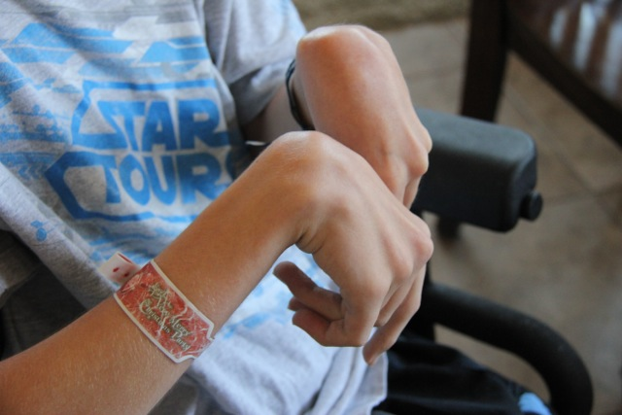
Introduction (Cont…)
Upper Limb Disability
Fig 1: Paralysed hand of a person[1]
[1] https://theblessingcounter.blogspot.com/

Slide 5
Introduction (Cont…)
What causes disability?
According to the World Health Organization, every year approximately 15 million people around the world suffer from stroke [2] and among them 70–80% experience upper-extremity impairment [3]
In USA alone, 17,900 new cases of spinal cord injury each year [4]
[2] R. Rodrigo, R. Fernandez-Gajardo, R. Gutierrez, J. Manuel Matamala, R. Carrasco, A. Miranda-Merchak, and W. Feuerhake, “Oxidative stress and pathophysiology of ischemic stroke: novel therapeutic opportunities,” CNS & Neurological Disorders-Drug Targets (Formerly Current Drug Targets- CNS & Neurological Disorders), vol. 12, no. 5, pp. 698–714, 2013.
[3] X. Hu, K. Y. Tong, R. Song, V. S. Tsang, P. O. Leung, and L. Li, “Variation of muscle coactivation patterns in chronic stroke during robot-assisted elbow training,” Archives of physical medicine and rehabilitation, vol. 88, no. 8, pp. 1022–1029, 2007.
[4] Jain NB, Ayers GD, Peterson EN, Harris MB, Morse L, O'Connor KC, Garshick E. Traumatic spinal cord injury in the United States, 1993-2012. JAMA. 2015 Jun 9;313(22):2236-43. doi: 10.1001/jama.2015.6250. PMID: 26057284; PMCID: PMC4712685.

Slide 6
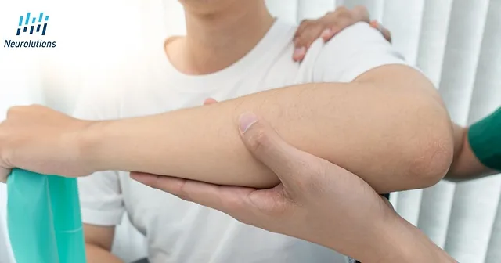
Introduction (Cont…)
Existing Treatments for Rehabilitation
Traditional stroke rehabilitation by physiotherapist or occupational therapist
Fig 2: Conventional physiotherapy[5]
[5]https://www.neurolutions.com/post/the-role-of-occupational-therapy-ot-after-a-stroke

Slide 7
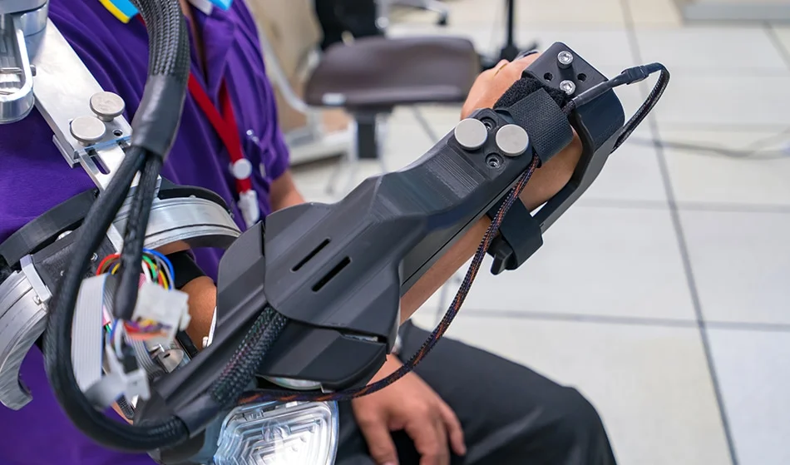
Introduction (Cont…)
Existing Treatments for Rehabilitation
Many robotic rehabilitation devices are developed for continuous passive movements or active-assisted movements. But they have some limitations like stiffness, discomfort, heavy etc.
Fig 3: Robotic assistive device[6]
[6] https://www.azorobotics.com/Article.aspx?ArticleID=116, last accessed 11/3/2023

Slide 8
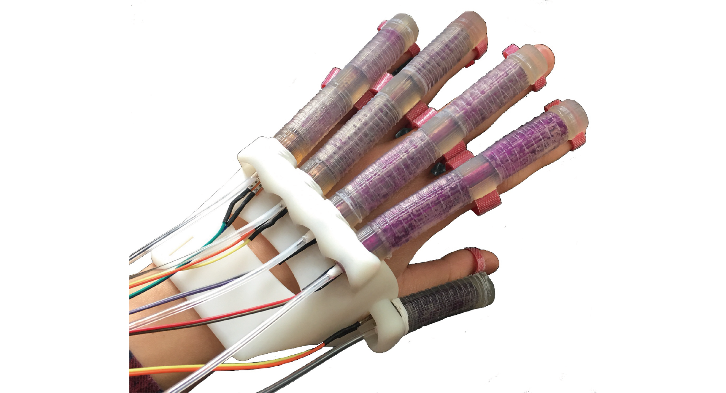
Introduction (Cont…)
Emerging Treatments for Rehabilitation
Soft robotics, an emerging area tries to solve the challenges faced by the traditional robotics
Fig 4: Soft robotic assistive device[7]
[7]https://exhibition.cintec.cuhk.edu.hk/projects/3d-printed-soft-robotic-hand-for-rehabilitation/, last accessed 11/3/2023

Slide 9
Introduction (Cont…)
Increasing need for innovative rehabilitation solutions
Motivation
Utilizing soft robotics’ breakthroughs
Improving life quality of affected individuals
Providing more effective means of functional recovery

Slide 10
Introduction (Cont…)
Project Statement
We propose,
To develop an assistive device for upper limb impaired patients
To incorporate of soft robotics in the device
To exercise the impaired limb with the help of actuation of the device to regain strength in that limb

Slide 11
Introduction (Cont…)
Objectives
To develop a design of the actuator for movement
To achieve the actuation using pneumatic control
2
4
1
3
To use soft material for the fabrication of actuator
To achieve extension and flexion of wrist with the actuator

Slide 12
Related Works

Slide 13
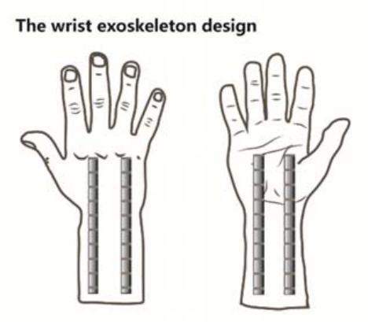
Related Works (Cont…)
Design and Simulation of a Soft Robotic Device for Wrist Rehabilitation [8]
Strengths
The device is lightweight
The extension, flexion can be done at large scales
The device can be used on different individuals
Limitations
The device hasn’t been tested on humans
The device’s long-term durability is unknown
Possible obstacles to using the device in a clinical context are not discussed
Fig 5: Design of Wrist Exoskeleton. [8]
[8] Y. Xu, “Design and simulation of a soft robotic device for wrist rehabilitation,” in 2020 3rd International Conference on Advanced Electronic Materials, Computers and Software Engineering (AEMCSE). IEEE, 2020, pp. 697–701.

Slide 14
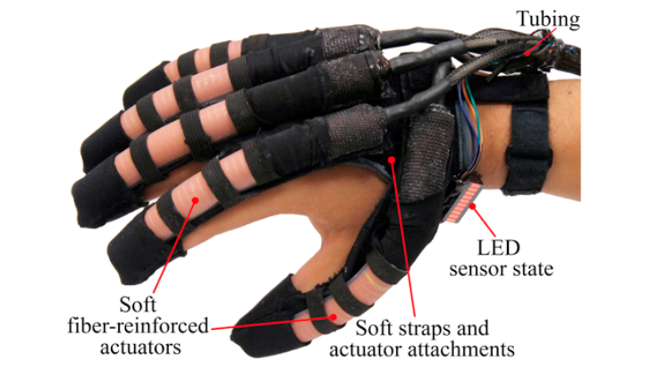
Related Works (Cont…)
Soft Robotic Glove for Combined Assistance and At-home Rehabilitation [9]
Strengths
The soft materials of the glove are comfortable
It can perform several hours with single charge
It is inexpensive
It has an open palm design
Limitations
The sample size is relatively small
It does not include a pilot study
It’s long-term efficacy is unknown
Fig 6: The prototyped soft and lightweight robotic hand assistive device. [9]
[9] P. Polygerinos, Z. Wang, K. C. Galloway, R. J. Wood, and C. J. Walsh, “Soft robotic glove for combined assistance and at-home rehabilitation,” Robotics and Autonomous Systems, vol. 73, pp. 135–143, 2015.

Slide 15
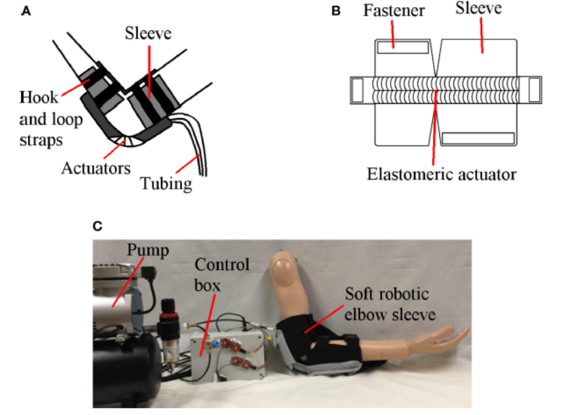
Related Works (Cont…)
Design of a Soft Robotic Elbow Sleeve with Passive and Intent-Controlled Actuation [10]
Strengths
This work uses soft actuators made of lightweight fabric and fiber reinforcement
It is effective at producing and maintaining the elbow’s essential flexion and extension
Limitations
There is still an unfavorable frequency switching during actuation
The primary foundation is basic on-off algorithm
Fig 7: The soft robotic elbow sleeve for stroke rehabilitation (A) Illustration of the soft robotic sleeve, (B) Schematic of the flexion actuator, (C)Fully assembled system. [10]
[10] T. H. Koh, N. Cheng, H. K. Yap, and C.-H. Yeow, “Design of a soft robotic elbow sleeve with passive and intent-controlled actuation,” Frontiers in neuroscience, vol. 11, p. 597, 2017.

Slide 16
Related Works (Cont…)
Reference No. | Strengths | Limitations
[11] | Light and easy to wear Can be customized Safe for the users | No motion model Limited bending sensors No simulated evaluation
[12] | The use of flexible materials Evaluated by several trials Can exert enough pressure | No inflatable beam model Occurs significant dislodging
[13] | Lightweight and easy to wear Isolated flexion, extension actuators Grip strength evaluation is done | A small sample group Glove is not customizable Fabric-based sensors inaccurate
[14] | Can bear pressure 2.5 times more than SDM Takes less time than the traditional SDM | The emerging speed of molds must be controlled Offers limited range of tasks
… | … | …
[11] D. Hu, J. Zhang, Y. Yang, Q. Li, D. Li, and J. Hong, “A novel soft robotic glove with positive-negative pneumatic actuator for hand rehabilitation,” in 2020 IEEE/ASME International Conference on Advanced Intelligent Mechatronics AIM). IEEE, 2020, pp. 1840–1847
[12] R. F. Natividad and C.-H. Yeow, “Development of a soft robotic shoulder assistive device for shoulder abduction,” in 2016 6th IEEE International Conference on Biomedical Robotics and Biomechatronics (BioRob). IEEE, 2016, pp. 989–993
[13] H. K. Yap, P. M. Khin, T. H. Koh, Y. Sun, X. Liang, J. H. Lim, and C.-H. Yeow, “A fully fabric-based bidirectional soft robotic glove for assistance and rehabilitation of hand impaired patients,” IEEE Robotics and Automation Letters, vol. 2, no. 3, pp. 1383–1390, 2017
[14] Y. Jiang, D. Chen, J. Que, Z. Liu, Z. Wang, and Y. Xu, “Soft robotic glove for hand rehabilitation based on a novel fabrication method,” in 2017 IEEE International Conference on Robotics and Biomimetics (ROBIO). IEEE, 2017, pp. 817–822

Slide 17
Material selection
Prototype design
Work already done
Mathematical Modeling
FEM Analysis & Simulation
Methodology
Grid Independent Test
Mold Fabrication
Actuator Fabrication
Expected works to be done
Control and Actuation
Final Assembly of Device

Slide 18
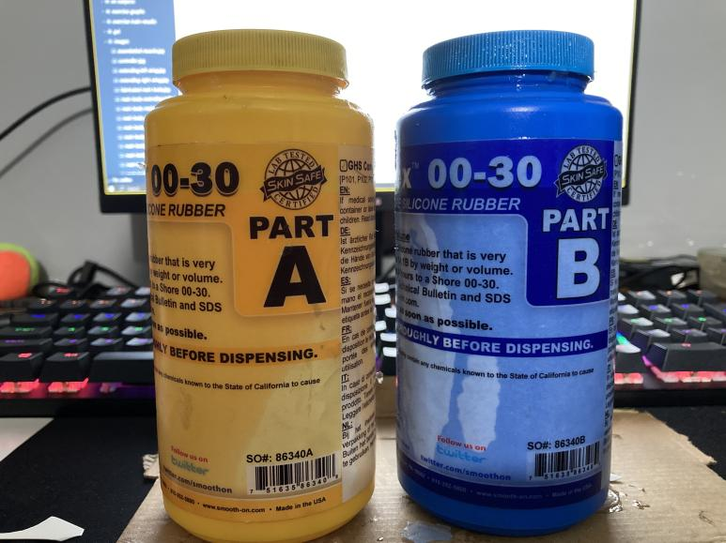
Methodology (Cont…)
Work Already Done
Material Selection
Ecoflex 00-30
Wider temperature range (-65F to 450F)
Resilience to wear and tear
Stretchable and deformable without ripping (Elongation of 900%)
High chemical resistance

Slide 19
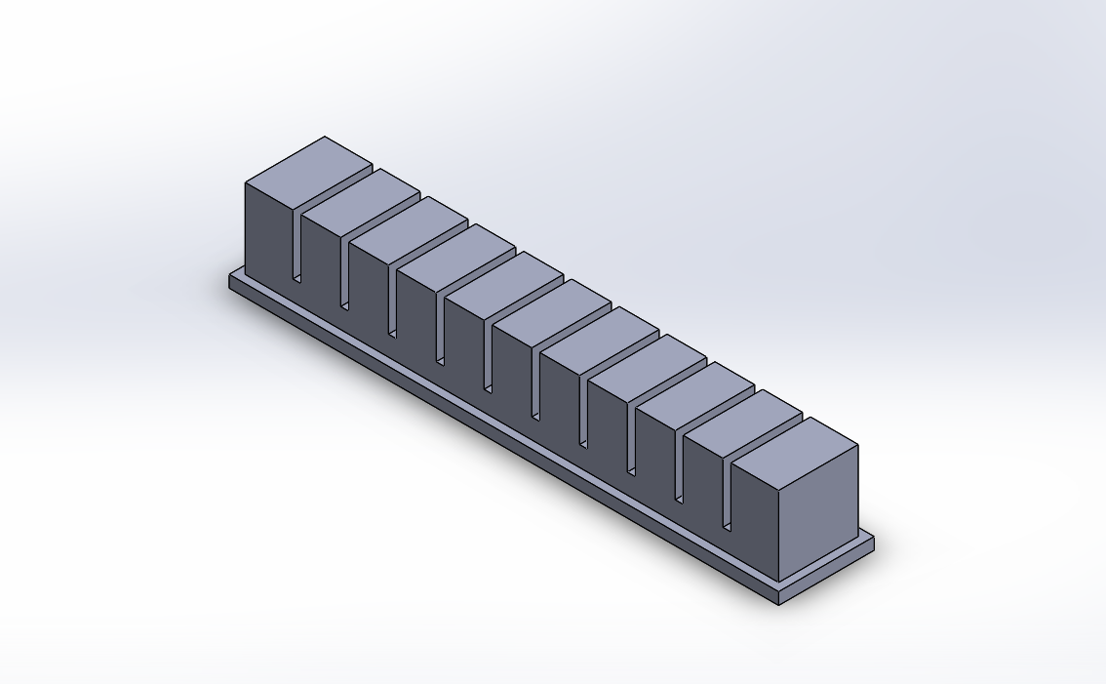
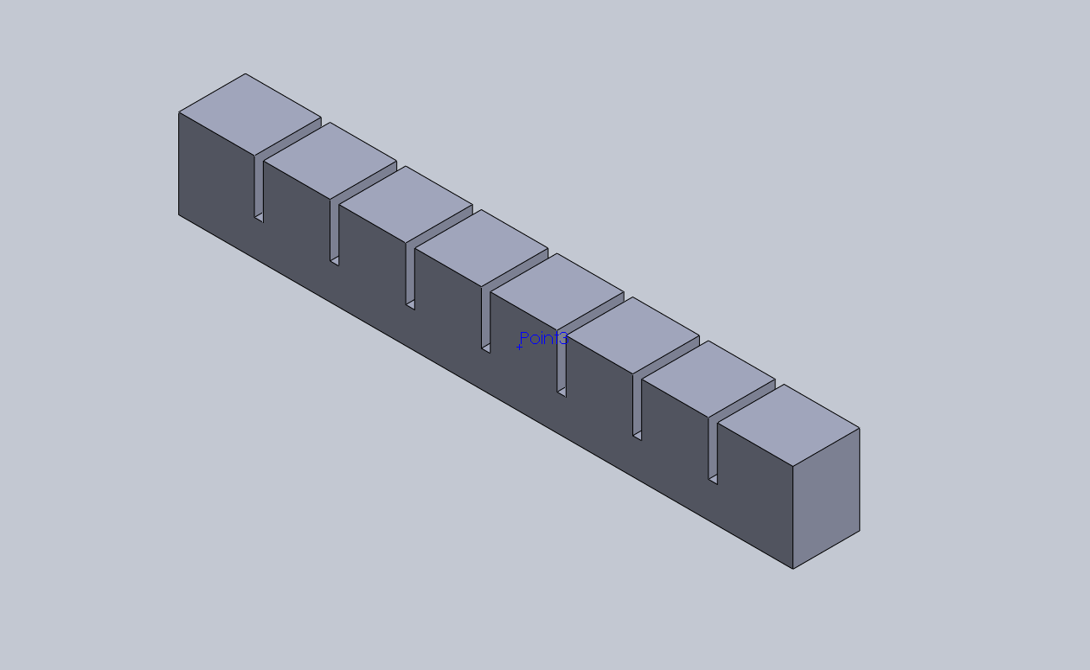
Methodology (Cont…)
Work Already Done
Prototype design
PneuNets Bending Actuator[15]
Fig 8: Isometric view of previous prototype
Fig 9: Isometric view of modified prototype
[15] Soft robotics toolkit. [Online]. Available: https://softroboticstoolkit.com/

Slide 20
Methodology (Cont…)
Work Already Done
Factors influencing bending angle and force [16]-
1
2
3
4
5
Base layer thickness
Thickness of boundary wall
Gap size between two chambers
Air chamber height
Number of air chambers
Thicker base leads to good bending
For rapid actuation walls thinner are considered suitable
Higher gap leads to higher bending but causes damage to channels
Increased height leads to greater force output
For fixed length, more chamber gives more bending
[16] M. Xavier, A. Fleming, and Y. K. Yong, “Finite element modeling of soft fluidic actuators: Overview and recent developments,” Advanced Intelligent Systems, vol. 3, 10 2020

Slide 21
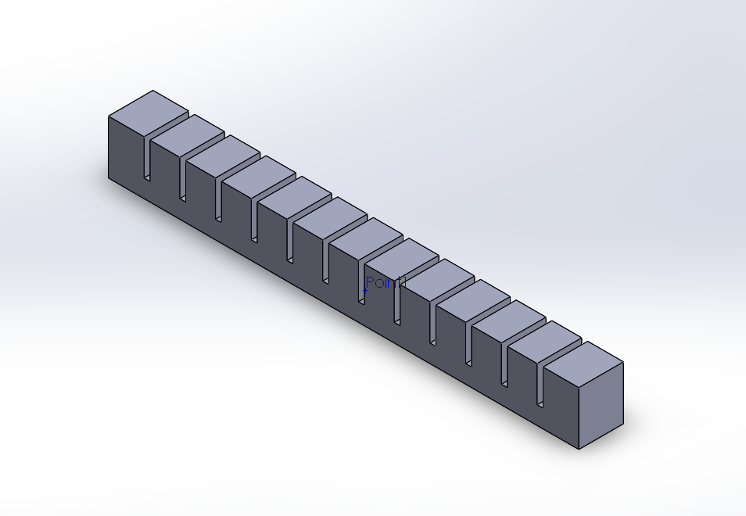
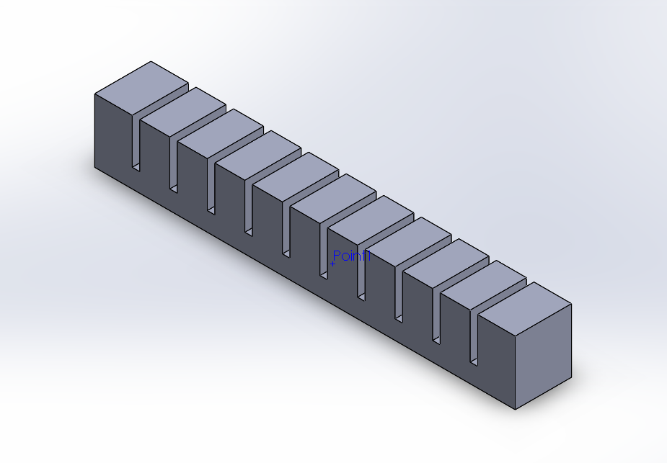
Methodology (Cont…)
Work Already Done
Prototypes
Fig 10: Isometric view of prototype-1
Fig 12: Isometric view of prototype-3
Fig 11: Isometric view of prototype-2
Fig 13: Isometric view of prototype-4

Slide 22
Methodology (Cont…)
Work Already Done
Designs | No. of Chambers | Wall Thickness | Base Thickness | Gap Length
1 | 11 | 3 | 3 | 2
2 | 11 | 2 | 2 | 3
3 | 13 | 2 | 2 | 2
4 | 8 | 4 | 5 | 2
5 | 8 | 4 | 5 | 3
Table 1: Important parameter values taken for different designs of prototypes
Fig 14: Modified prototype

Slide 23
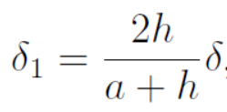
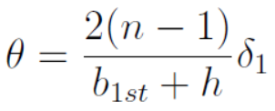
Methodology (Cont…)
Work Already Done
Mathematical Modeling
Θ = bending angle
δ = maximum displacement of the chamber lateral wall
δ1 = displacement of the chamber lateral wall in the gap layer
a = height of the inner chamber
h = height of the gap
R = bending curvature
b1st = thickness of the 1st layer base
l = length of one chamber
lgap = length of the gap
n = number of chambers
[17]
[17] Z. Liu, F. Wang, S. Liu, Y. Tian, and D. Zhang, “Modeling and analysis of soft pneumatic network bending actuators,” IEEE/ASME Transactions on Mechatronics, vol. 26, no. 4, pp. 2195–2203, 2020.

Slide 24
Methodology (Cont…)
Work Already Done
Finite Element Method(FEM)
Analysis
COMSOL Software
Hyperelastic Material
Yeoh Model
Solid Mechanics
Mesh & Stationary Study
Used for simulation of the design
Incompressible material
Ecoflex 00-30
Result matches to experimental data in case of both small and large strain values
Used for analysis of mechanical structures subjected to static or dynamic loads
Meshing is a discretization technique used in computing FEM.
Field variable unchanged over time

Slide 25
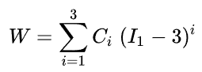
Methodology (Cont…)
Work Already Done
It is a model for the deformation of nearly incompressible, nonlinear elastic materials such as rubber
Yeoh Model
It is based on strain-energy density function observation of Ronald Rivlin

Slide 26
Methodology (Cont…)
Work Already Done
Parameters
Value
Material Mode
Hyperelastic
Material Model
Yeoh
Simulation Parameters
Compressibility
Incompressible
C1
12.7kPa [18]
C2
423Pa [18]
C3
-1.46Pa [18]
ρ
1070 kg/m^3
Load
Pressure
[18] M. Xavier, A. Fleming, and Y. K. Yong, “Finite element modeling of soft fluidic actuators: Overview and recent developments,” Advanced Intelligent Systems, vol. 3, 10 2020.
Mesh
Fine
Table 2: Selected parameter values and types for simulation

Slide 27
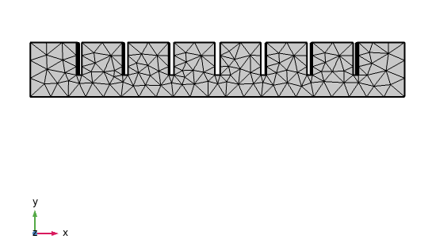
Methodology (Cont…)
Work Already Done
Fig 15: Physics-controlled generated mesh of the modified prototype

Slide 28
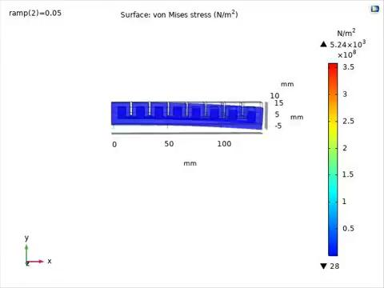
Methodology (Cont…)
Work Already Done
Vid 1: Animation video of the simulation

Slide 29
Methodology (Cont…)
Work Already Done
Grid Independent Test (GIT)
Mesh Type
No. of Elements
Coarser
1558
Coarse
2218
Normal
2829
To check whether the study result is dependent on the mesh size or not
Fine
4614
Finer
4578
Table 3: Mesh types for GIT

Slide 30
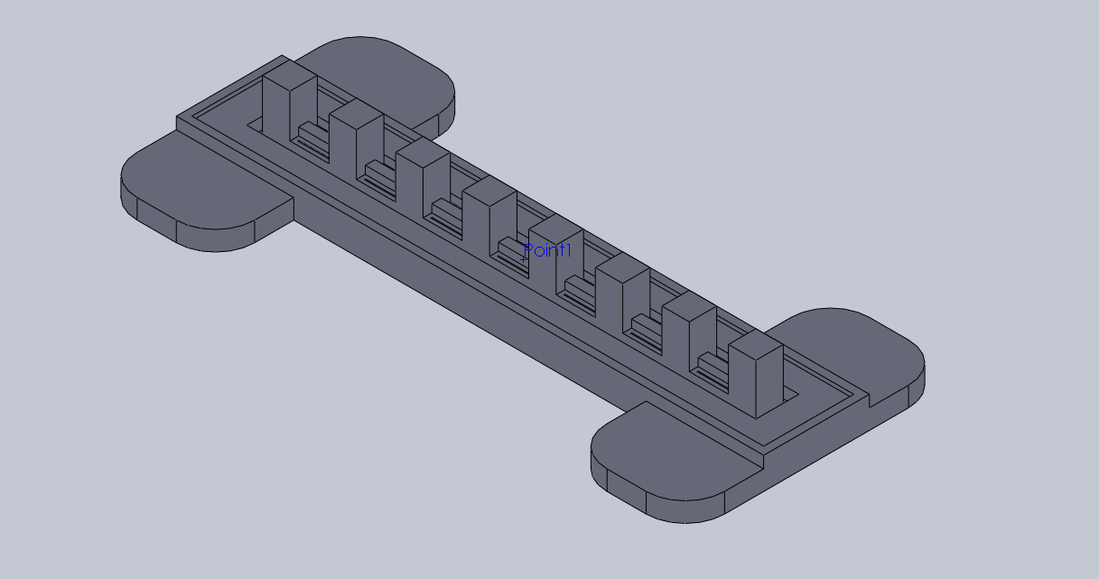
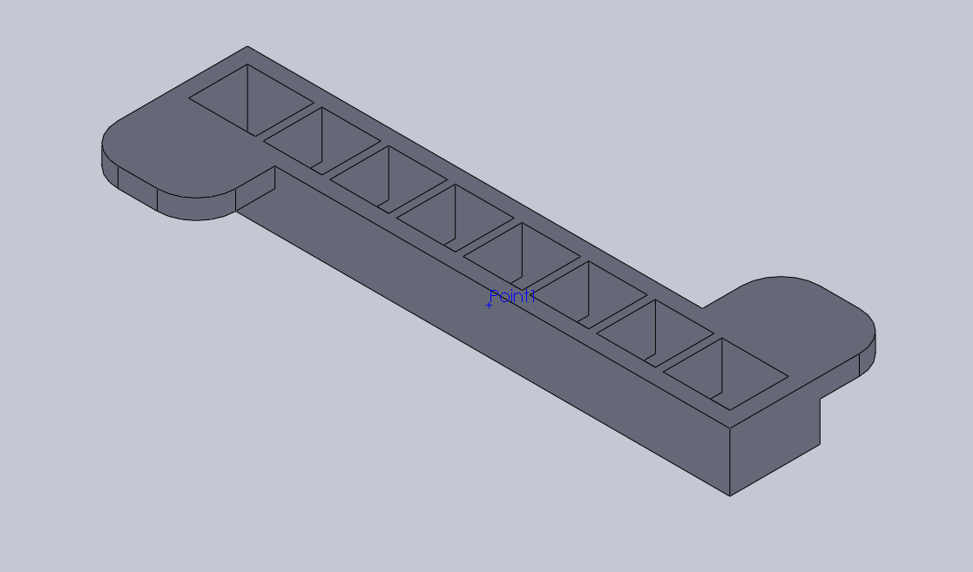
Methodology (Cont…)
Work Already Done
Mold Design
Bottom
Top
Fig 16: Isometric view of bottom layer
Fig 17: Isometric view of top layer

Slide 31
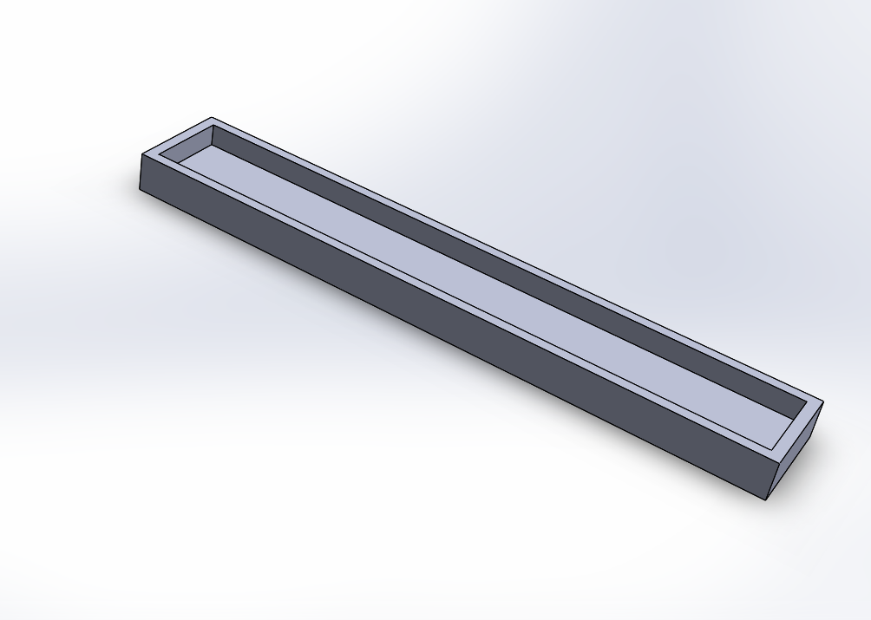
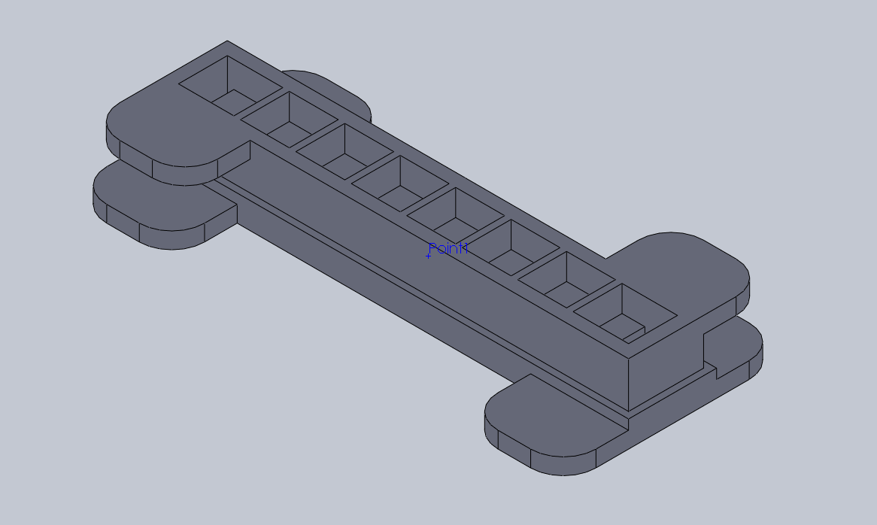
Methodology (Cont…)
Work Already Done
Mold Design
Base
Assembly
Fig 18: Isometric view of base layer
Fig 19: Isometric view of assembled mold

Slide 32
Methodology (Cont…)
Work Already Done
Mold Fabrication
For fabricating the mold we used Polylactic Acid(PLA) material.
Generating .SLT file from mold design
Importing the file to ‘Ultimaker Cura’ Software and slice it
Insert the sliced file into the memory card of the printer
Print the final mold

Slide 33
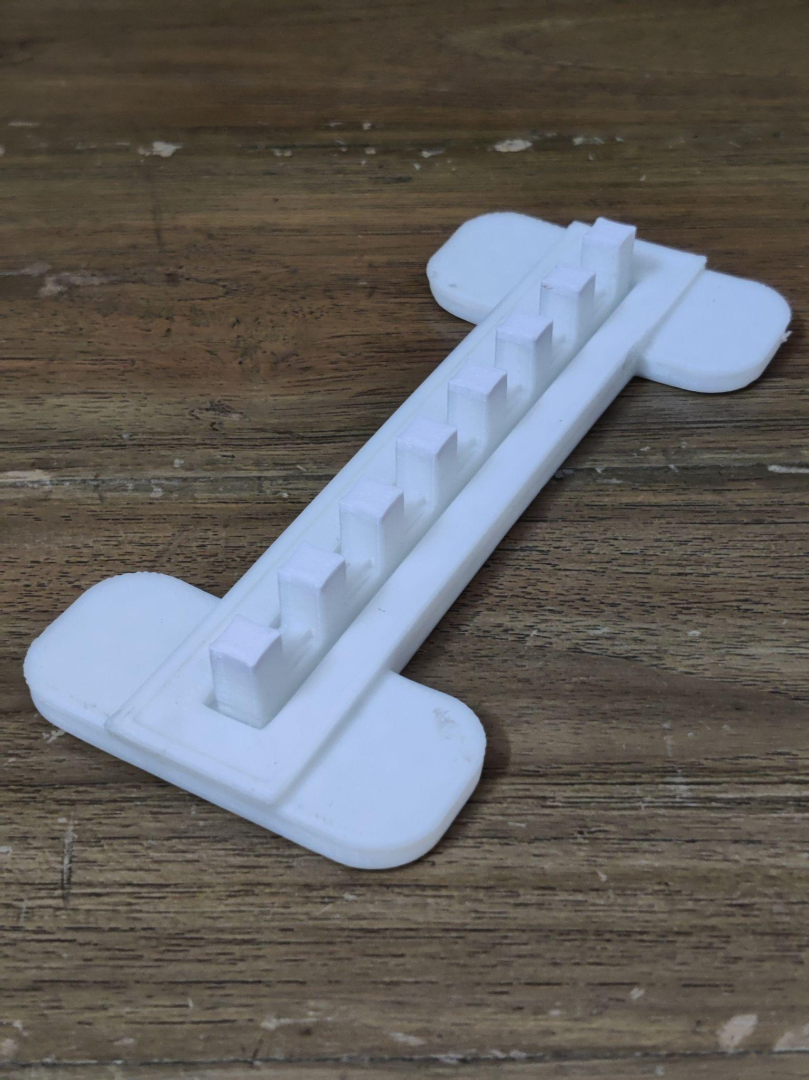
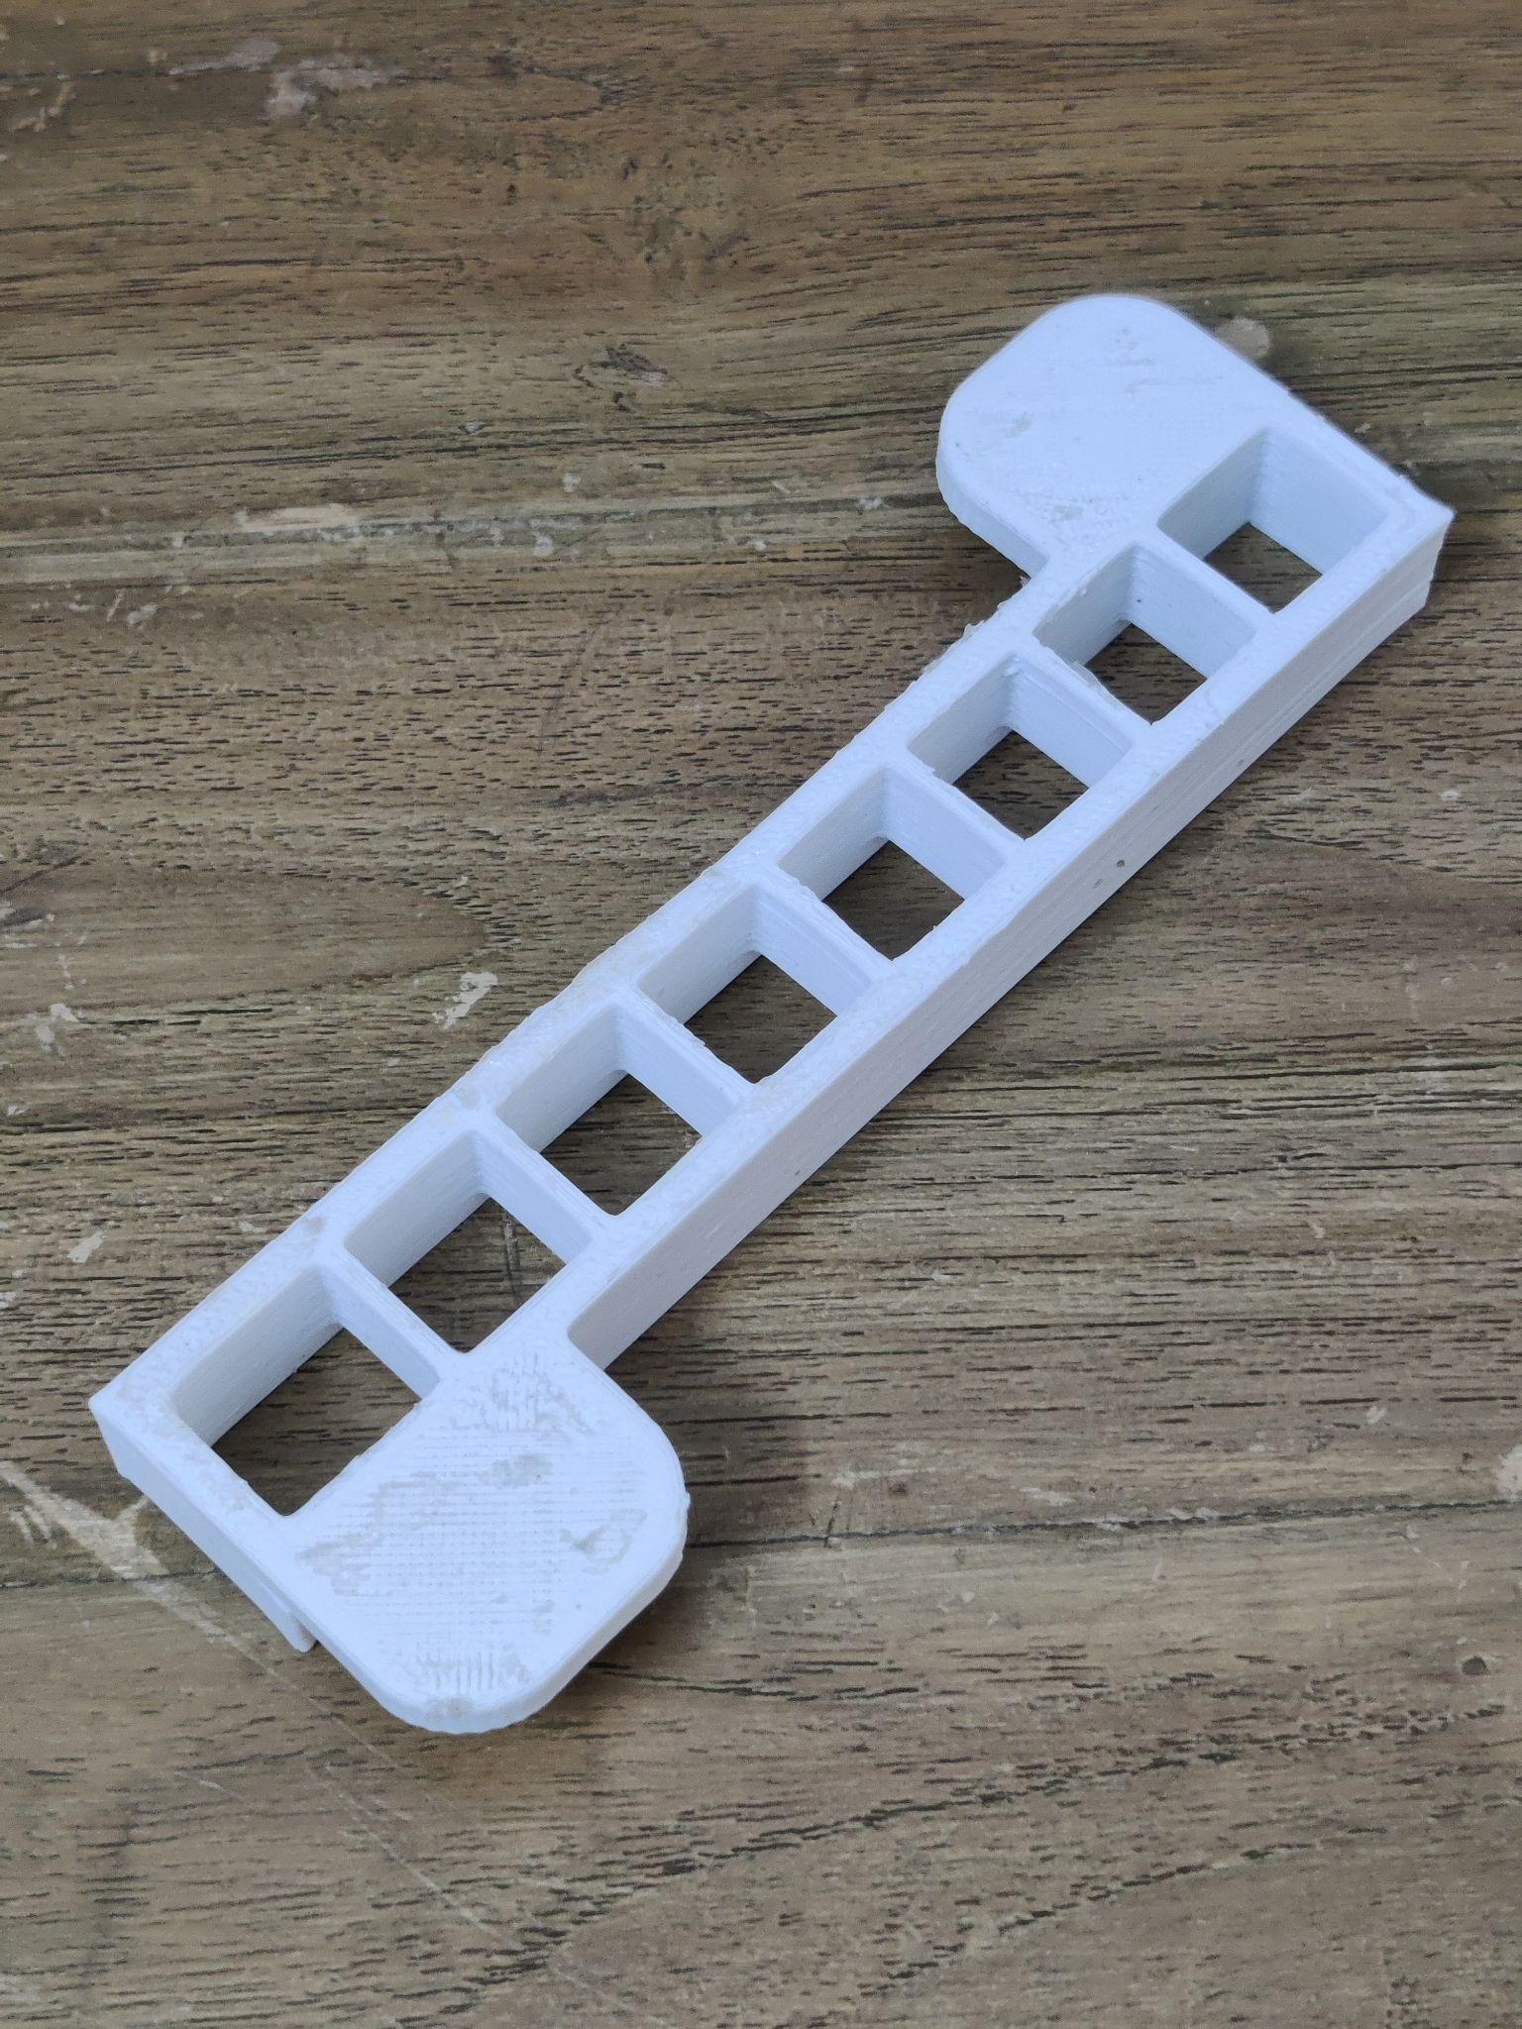
Methodology (Cont…)
Work Already Done
Bottom
Top
Fig 20: Mold of bottom layer
Fig 21: Mold of top layer

Slide 34
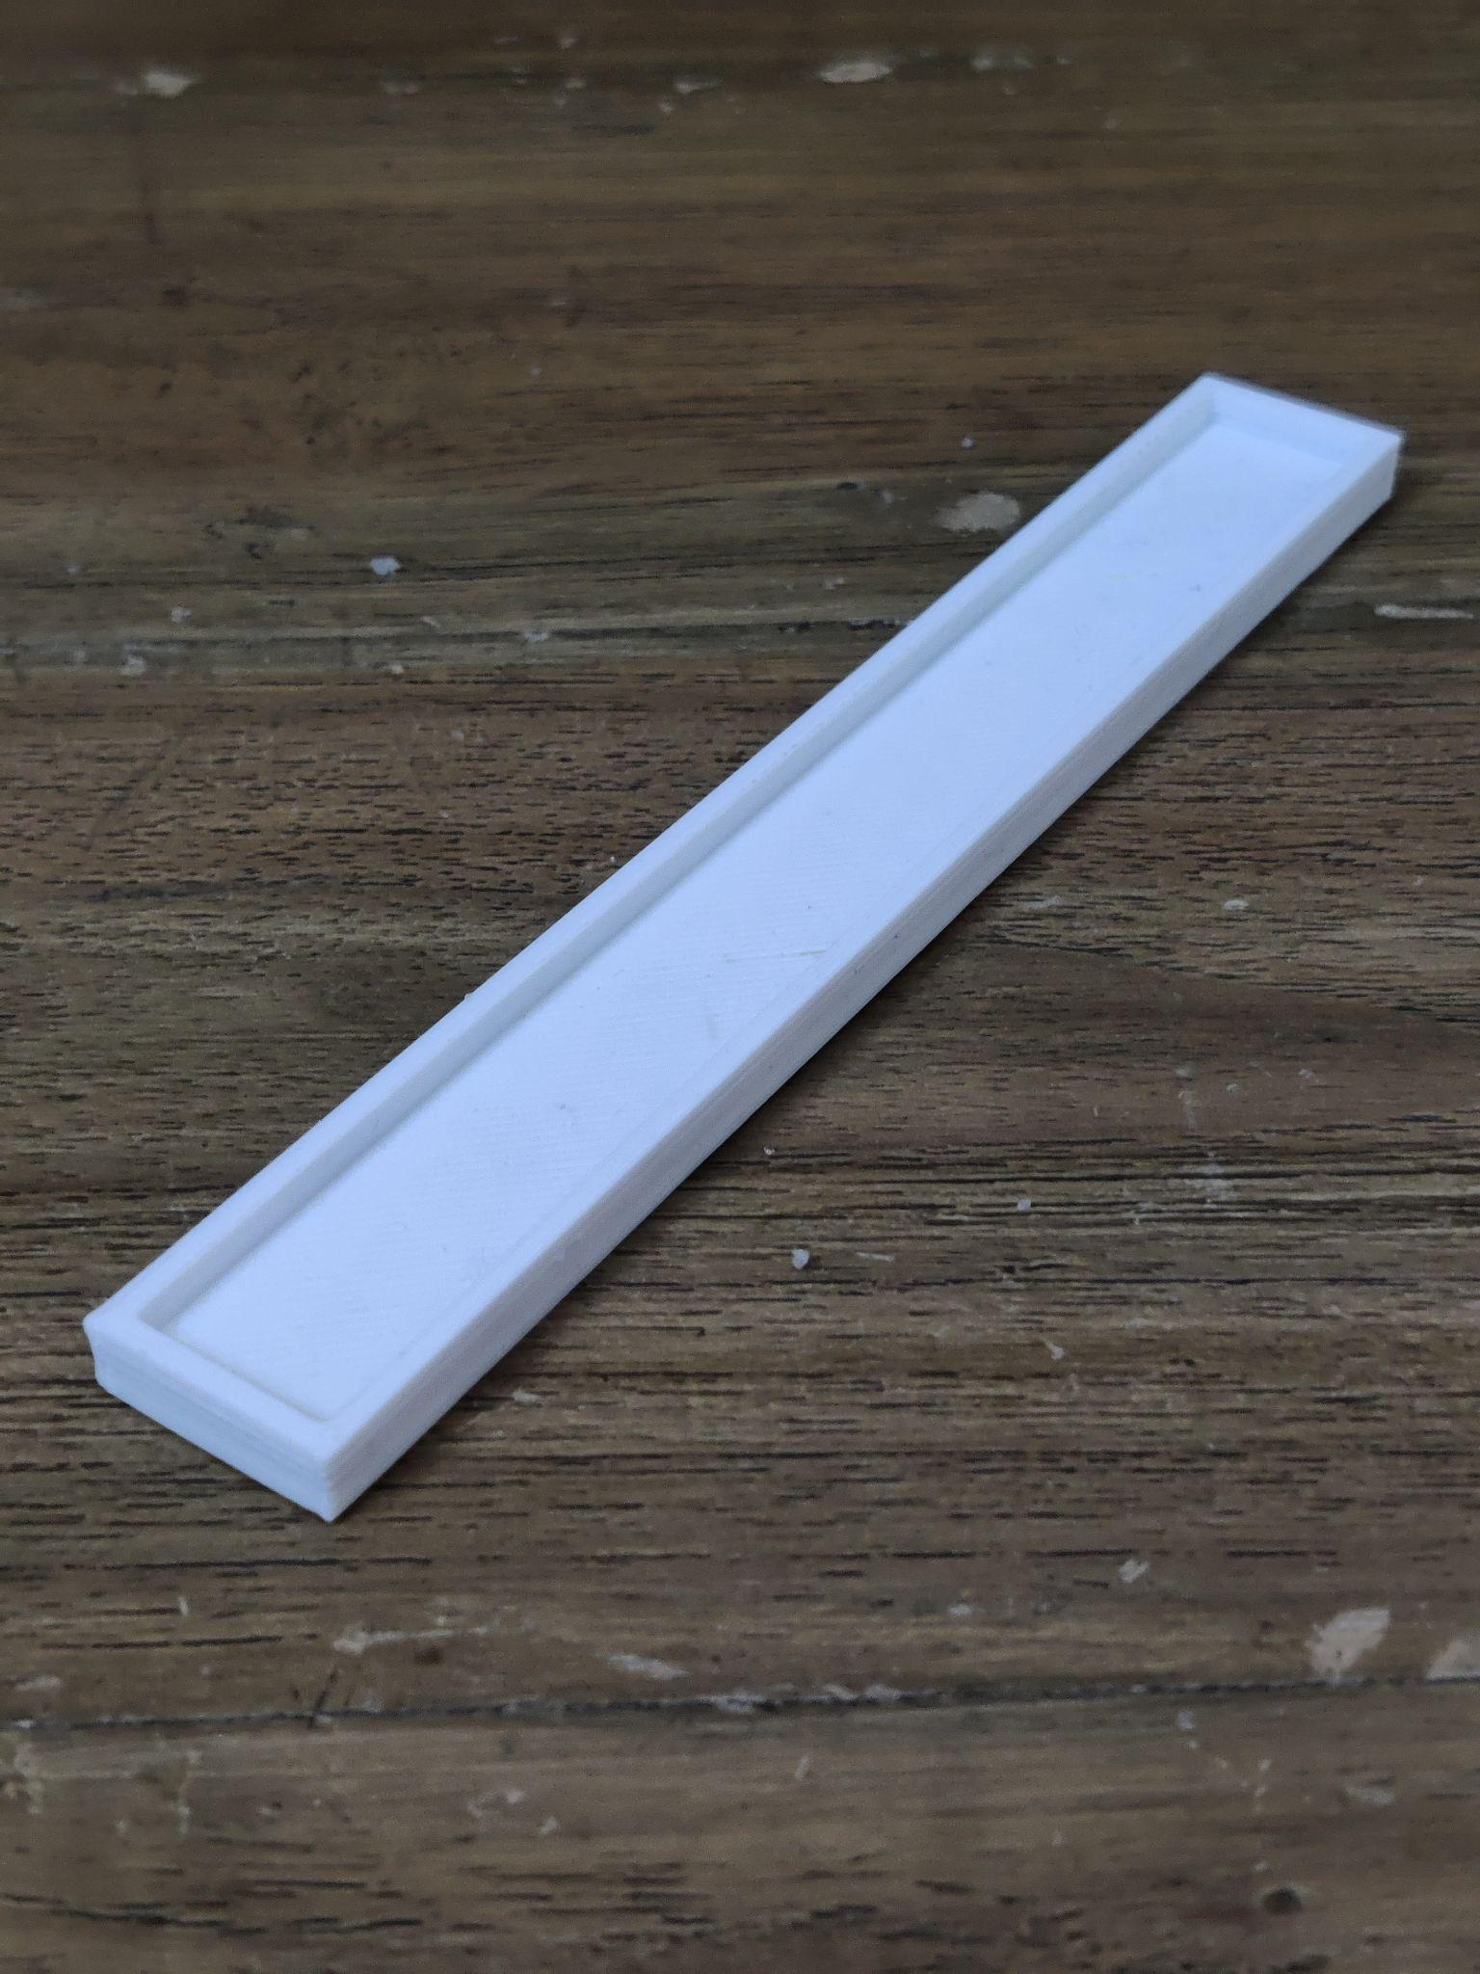
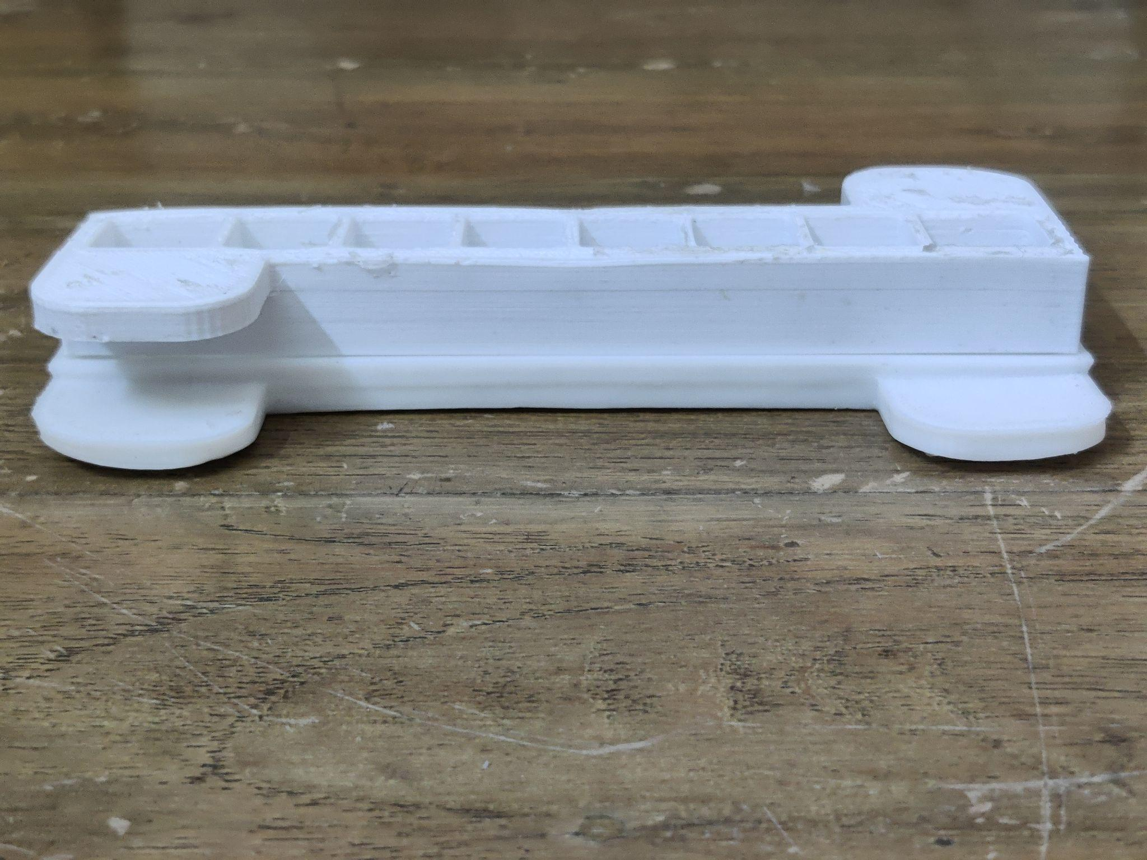
Methodology (Cont…)
Work Already Done
Assembly
Base
Fig 22: Mold of base layer
Fig 23: Assembled fabricated mold

Slide 35
Methodology (Cont…)
Work Already Done
Actuator Fabrication
The fabrication is done in 5 steps-
Step 1
Step 2
Step 3
Step 4
Step 5
Poured ecoflex in assembled mold and the base mold
Kept in room temperature for about 4 hours to for curing
Removal of cast after 4 hours
Merged the body and the base layer
The final cast was removed from mold

Slide 36
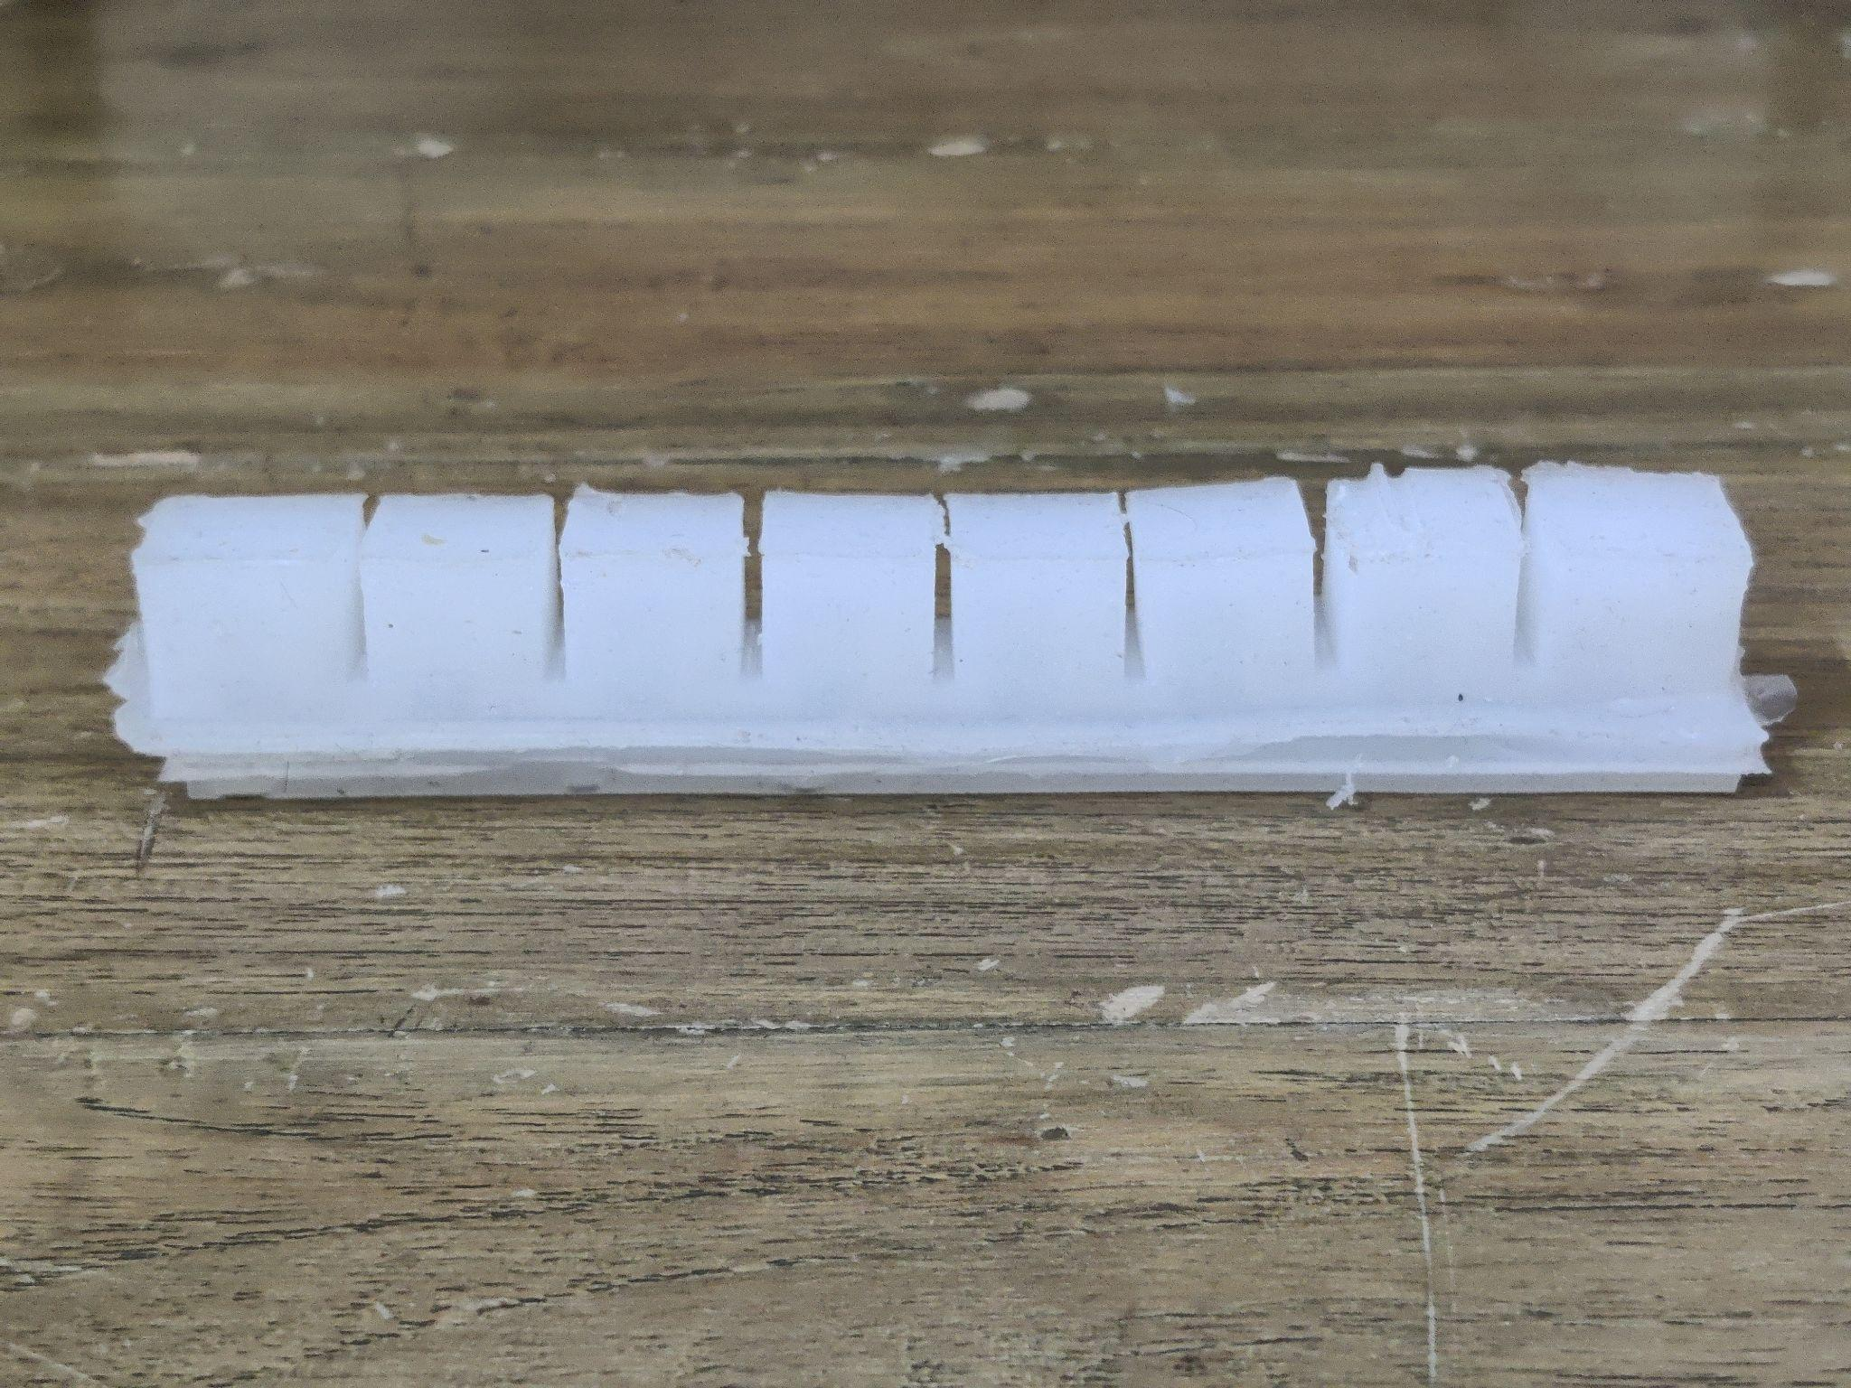
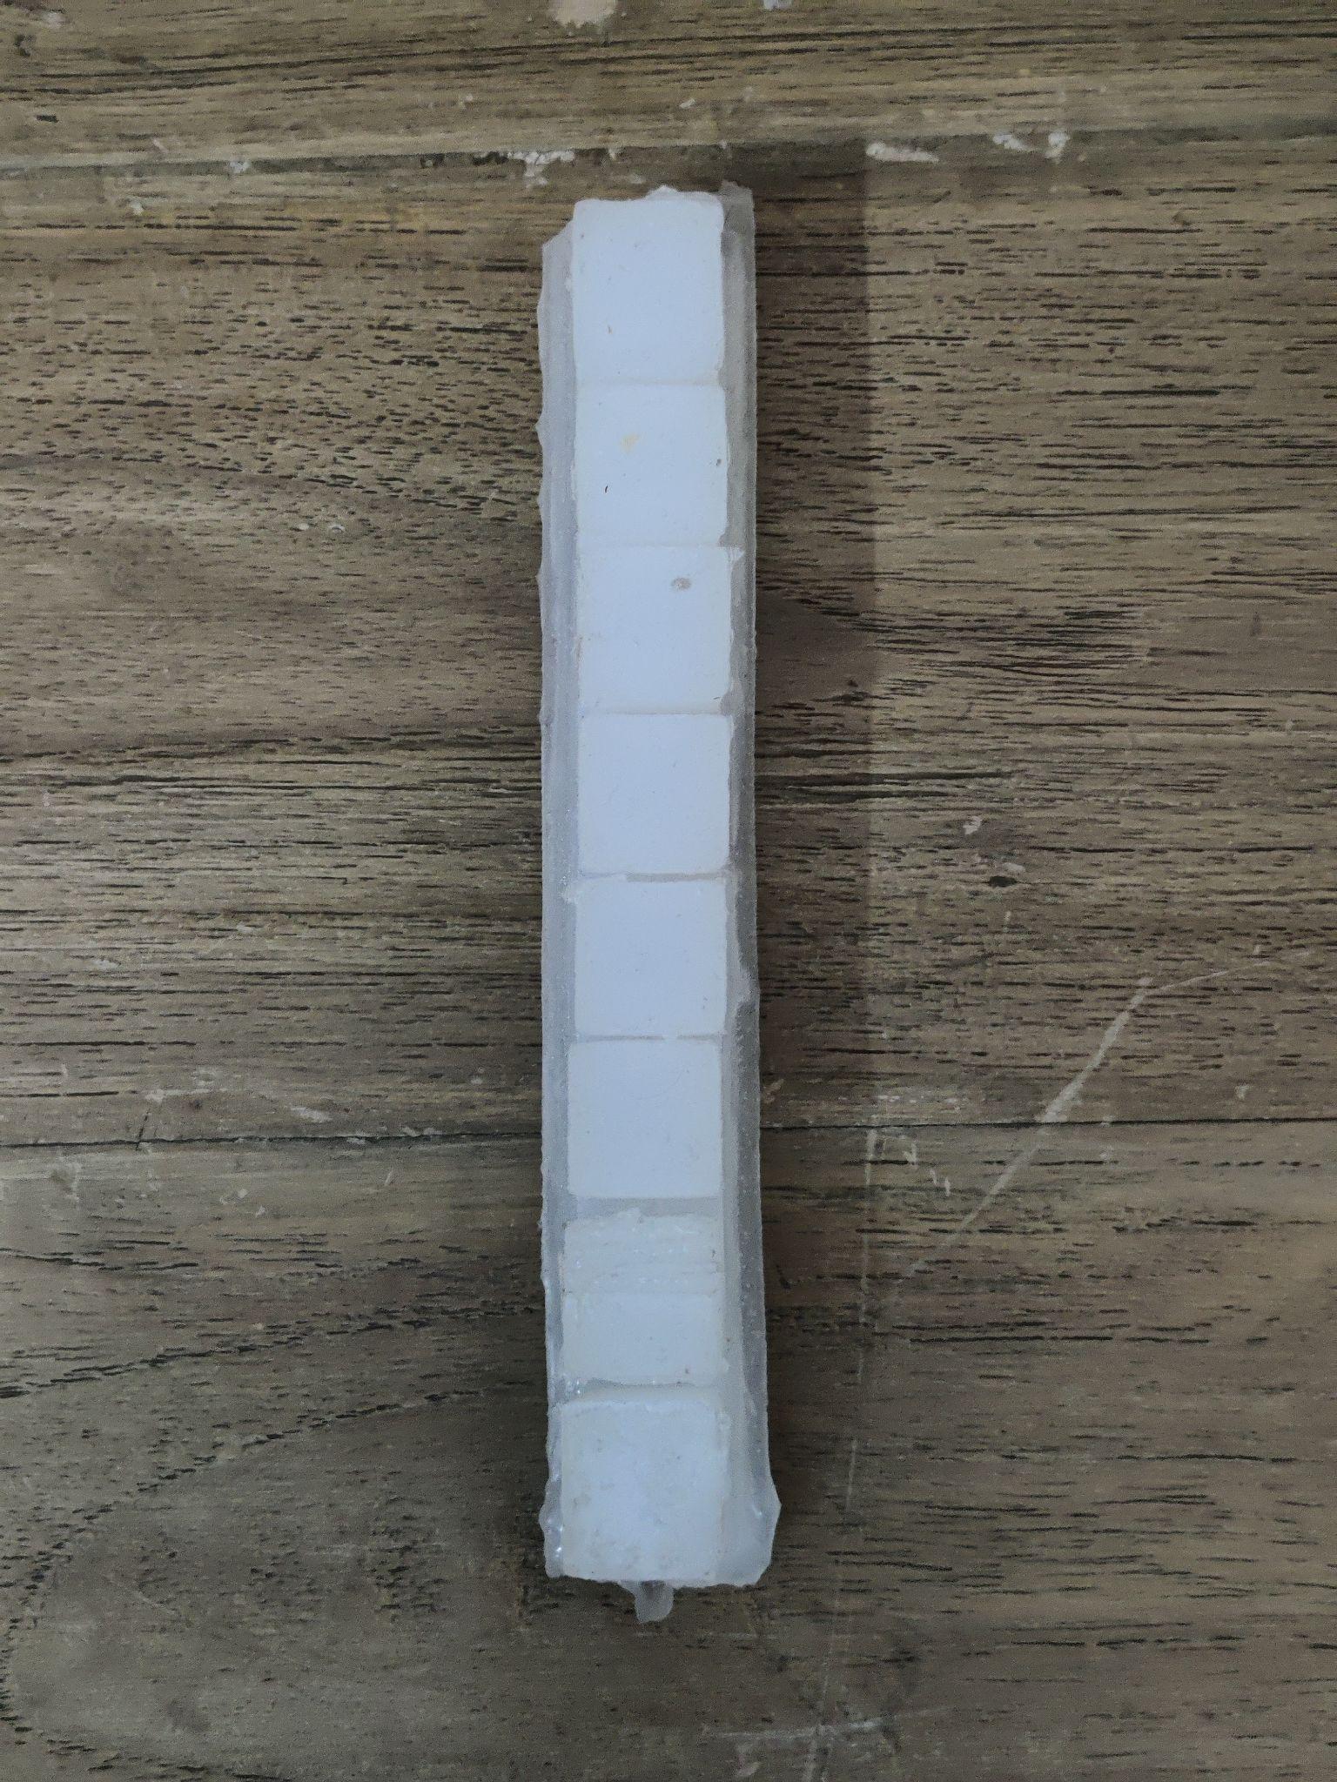
Methodology (Cont…)
Work Already Done
Fig 24: Front view of the main body
Fig 25: Top view of the main body

Slide 37
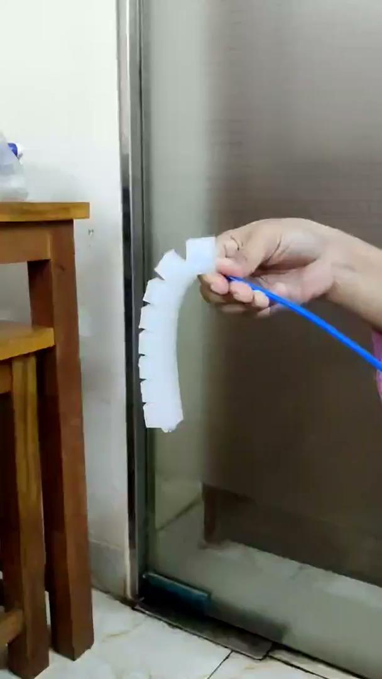
Methodology (Cont…)
Work Already Done
Control and Actuation
Vid 2: Bending experiment in real environment

Slide 38
Methodology (Cont…)
Expected works to be Done
The control unit will have
Arduino Uno Microcontroller
Power source
Compressor
Pneumatic tubes
Solenoid valve
Pressure sensor
Force sensor
Flex/bend sensor
Control & Actuation

Slide 39
Methodology (Cont…)
Expected works to be Done
Sensor Reading
Compressor
Working Principle of Control & Actuation
Actuation of soft actuator
Arduino Uno Microcontroller
Solenoid valve

Slide 40

Results

Slide 41
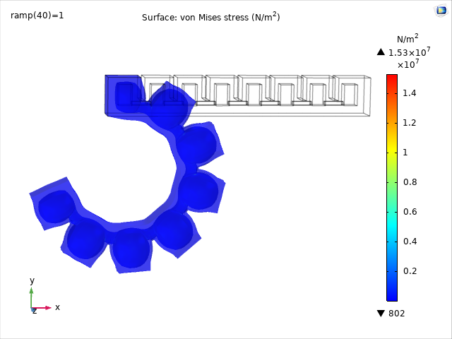
Results (Cont…)
Withstands 20kPa Pressure
Fig 26: 3D stress plot of deformed prototype at 20kPa

Slide 42
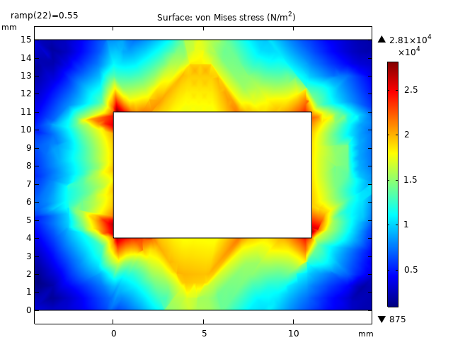
Results (Cont…)
Stress Plot(2D)
Maximum stress at inner corners of air chamber
Outer walls of chambers are less prone to stress
Stress at inner walls of chamber is more than that at outer walls
Inner parts inflate more than outer parts
Fig 27: 2D plot of stress in a cross sectional plane of modified prototype

Slide 43
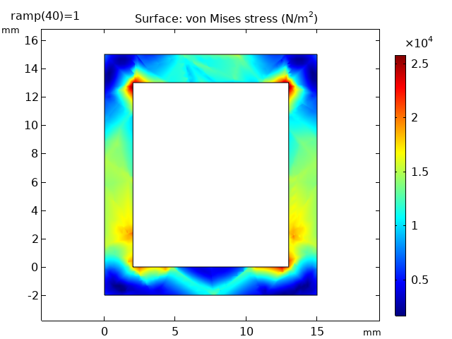
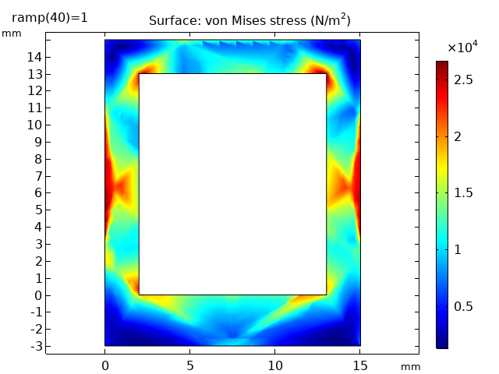
Results (Cont…)
Fig 28: 2D plot of stress in a cross sectional plane of prototype-2
Fig 29: 2D plot of stress in a cross sectional plane of prototype-3

Slide 44
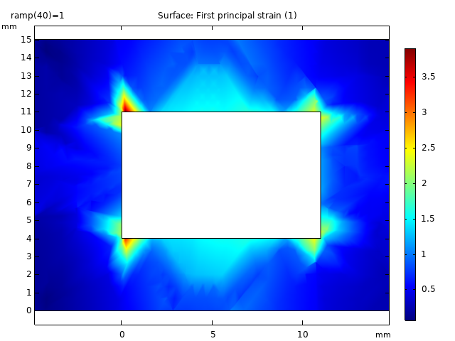
Results (Cont…)
Strain Plot
Maximum strain value at inner corners
Deformation in inner parts are greater than outer parts
Fig 30: 2D plot of strain in a cross sectional plane of modified prototype

Slide 45
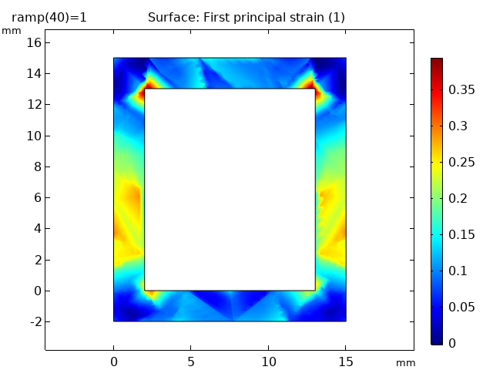
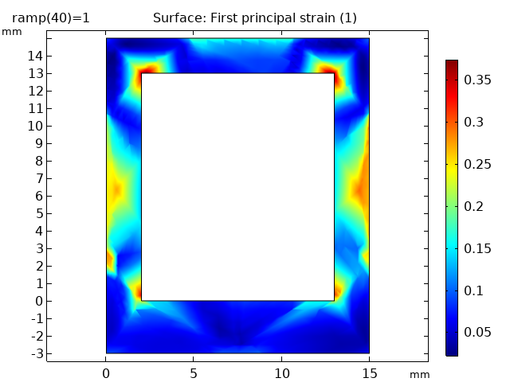
Results (Cont…)
Fig 31: 2D plot of strain in a cross sectional plane of prototype-2
Fig 32: 2D plot of strain in a cross sectional plane of prototype-3

Slide 46
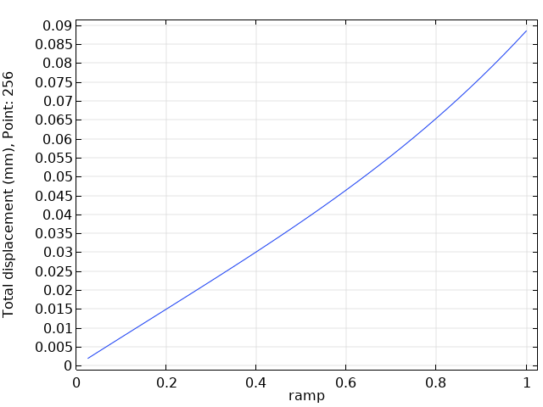
Results (Cont…)
Displacement Plot
Linear relationship between pressure and displacement
Displacement increases with pressure indicates bending
Fig 33: Displacement of a point of modified prototype

Slide 47
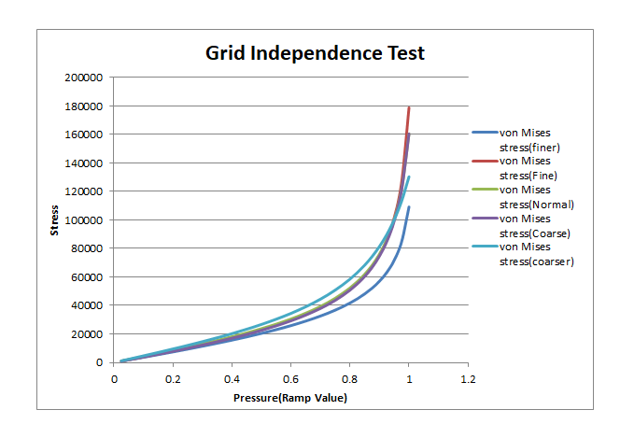
Results (Cont…)
Grid Independent Test Graph
Stress increases with pressure in each case
Stress line for normal, coarse and fine are almost same
Visible deviation for coarser and finer mesh
Fig 34: GIT result for coarser,coarse,normal,fine and finer mesh

Slide 48
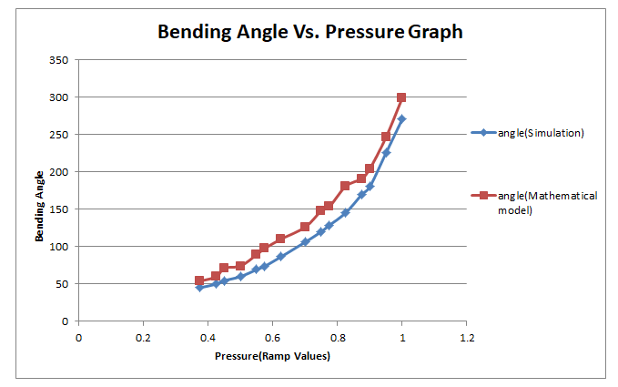
Results (Cont…)
Bending Angle Vs. Pressure Graph
Both are in linear trend
Deviation between two lines
Need to modify
Fig 35: Bending angle vs pressure graph from simulation data and mathematical model

Slide 49
Discussion and Conclusion

Slide 50
Discussion & Conclusion (Cont…)
Challenges During the Process:
Selecting proper number of chambers
Selecting proper width for chambers
Selecting the proper height for the chambers
No generalized information of how much pressure and force is needed in this kind of application

Slide 51
Discussion & Conclusion (Cont…)
Achievements:
Successfully simulated the model
Successfully fabricated molds for the cast
Successfully fabricated the actuator
Successful bending at comparatively higher pressure
Higher degrees of freedom

Slide 52
References
[1] https://theblessingcounter.blogspot.com/, last accessed 12/4/2023
[2] R. Rodrigo, R. Fernandez-Gajardo, R. Gutierrez, J. Manuel Matamala, R. Carrasco, A. Miranda-Merchak, and W. Feuerhake, “Oxidative stress and pathophysiology of ischemic stroke: novel therapeutic opportunities,” CNS & Neurological Disorders-Drug Targets (Formerly Current Drug Targets- CNS & Neurological Disorders), vol. 12, no. 5, pp. 698–714, 2013.
[3] X. Hu, K. Y. Tong, R. Song, V. S. Tsang, P. O. Leung, and L. Li, “Variation of muscle coactivation patterns in chronic stroke during robot-assisted elbow training,” Archives of physical medicine and rehabilitation, vol. 88, no. 8, pp. 1022–1029, 2007.
[4] Jain NB, Ayers GD, Peterson EN, Harris MB, Morse L, O'Connor KC, Garshick E. Traumatic spinal cord injury in the United States, 1993-2012. JAMA. 2015 Jun 9;313(22):2236-43. doi: 10.1001/jama.2015.6250. PMID: 26057284; PMCID: PMC4712685.
[5] https://www.neurolutions.com/post/the-role-of-occupational-therapy-ot-after-a-stroke, last accessed 12/4/2023
[6] https://www.azorobotics.com/Article.aspx?ArticleID=116, last accessed 11/3/2023
[7] https://exhibition.cintec.cuhk.edu.hk/projects/3d-printed-soft-robotic-hand-for-rehabilitation/, last accessed 12/4/2023
[8] Y. Xu, “Design and simulation of a soft robotic device for wrist rehabilitation,” in 2020 3rd International Conference on Advanced Electronic Materials, Computers and Software Engineering (AEMCSE). IEEE, 2020, pp. 697–701.
[9] P. Polygerinos, Z. Wang, K. C. Galloway, R. J. Wood, and C. J. Walsh, “Soft robotic glove for combined assistance and at-home rehabilitation,” Robotics and Autonomous Systems, vol. 73, pp. 135–143, 2015.
[10] T. H. Koh, N. Cheng, H. K. Yap, and C.-H. Yeow, “Design of a soft robotic elbow sleeve with passive and intent-controlled actuation,” Frontiers in neuroscience, vol. 11, p. 597, 2017.
[11] D. Hu, J. Zhang, Y. Yang, Q. Li, D. Li, and J. Hong, “A novel soft robotic glove with positive-negative pneumatic actuator for hand rehabilitation,” in 2020 IEEE/ASME International Conference on Advanced Intelligent Mechatronics AIM). IEEE, 2020, pp. 1840–1847.
[12] R. F. Natividad and C.-H. Yeow, “Development of a soft robotic shoulder assistive device for shoulder abduction,” in 2016 6th IEEE International Conference on Biomedical Robotics and Biomechatronics (BioRob). IEEE, 2016, pp. 989–993.
[13] H. K. Yap, P. M. Khin, T. H. Koh, Y. Sun, X. Liang, J. H. Lim, and C.-H. Yeow, “A fully fabric-based bidirectional soft robotic glove for assistance and rehabilitation of hand impaired patients,” IEEE Robotics and Automation Letters, vol. 2, no. 3, pp. 1383–1390, 2017.
[14] Y. Jiang, D. Chen, J. Que, Z. Liu, Z. Wang, and Y. Xu, “Soft robotic glove for hand rehabilitation based on a novel fabrication method,” in 2017 IEEE International Conference on Robotics and Biomimetics (ROBIO). IEEE, 2017, pp. 817–822.
[15] Soft robotics toolkit. [Online]. Available: https://softroboticstoolkit.com/, last accessed 12/4/2023

Slide 53
References
[16] M. Xavier, A. Fleming, and Y. K. Yong, “Finite element modeling of soft fluidic actuators: Overview and recent developments,” Advanced Intelligent Systems, vol. 3, 10 2020
[17] Z. Liu, F. Wang, S. Liu, Y. Tian, and D. Zhang, “Modeling and analysis of soft pneumatic network bending actuators,” IEEE/ASME Transactions on Mechatronics, vol. 26, no. 4, pp. 2195–2203, 2020.
[18] M. Xavier, A. Fleming, and Y. K. Yong, “Finite element modeling of soft fluidic actuators: Overview and recent developments,” Advanced Intelligent Systems, vol. 3, 10 2020.

Slide 54
Thank You!

